Slide 1
SPACEX DATA REPORT
ALEJANDRO MARTINEZ PANIAGUA

Slide 2
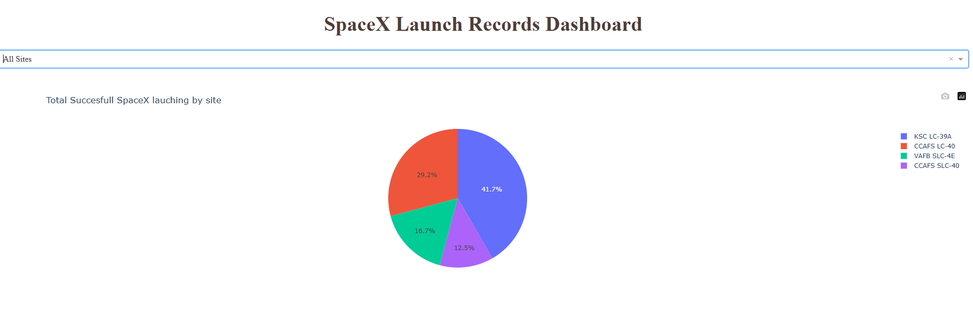
Which site has the largest successful launches? ANSWER: KSC LC-39A

Slide 3
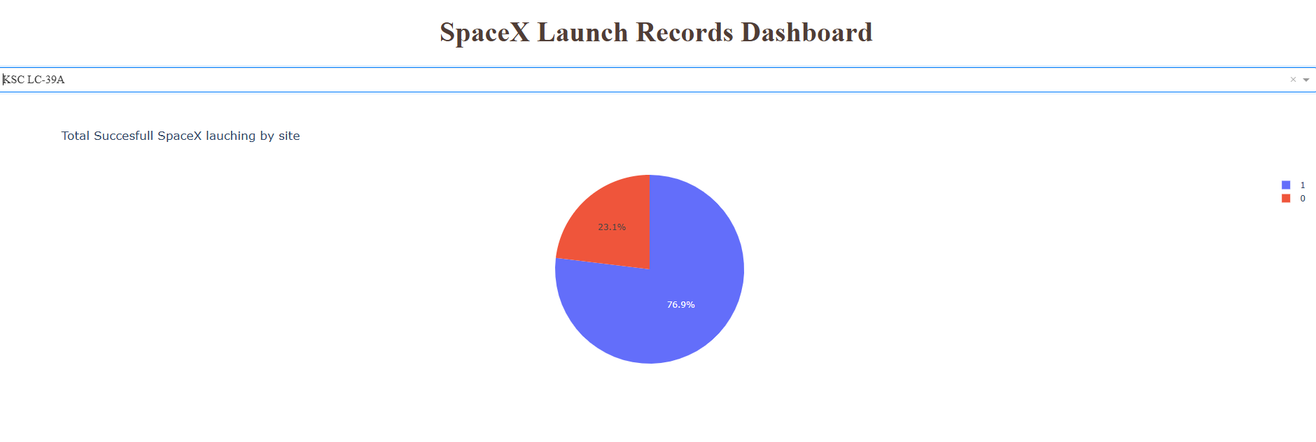
Which site has the highest launch success rate? Answer: ksc lc-39a

Slide 4
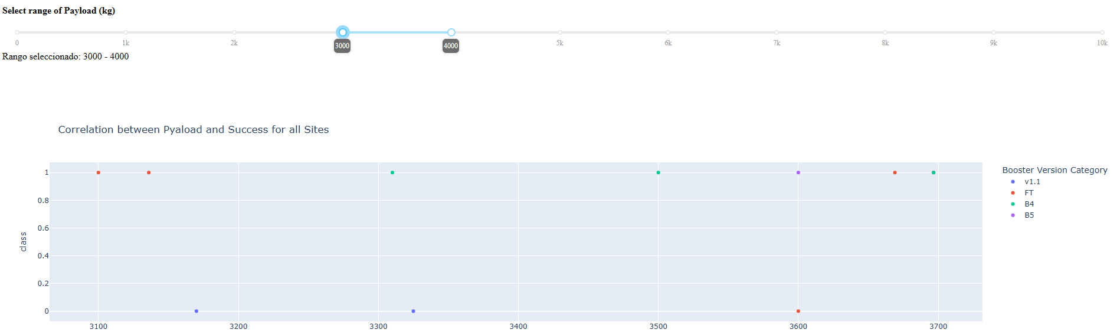
Which payload range(s) has the highest launch success rate? Answer: pl(kg) [3k-4k]= 70%

Slide 5
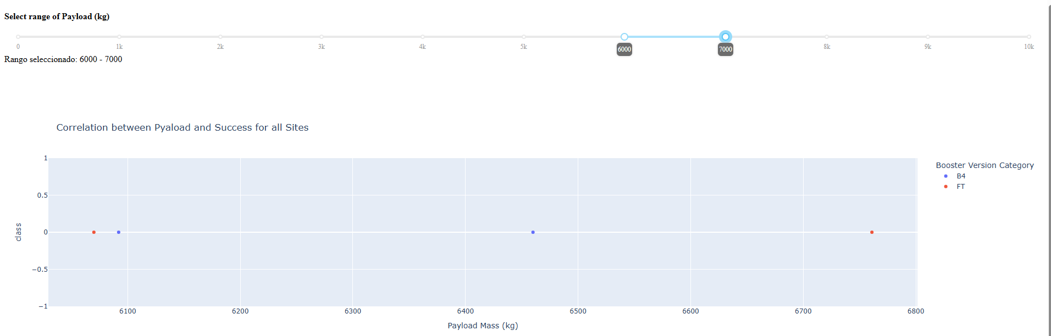
Which payload range(s) has the lowest launch success rate? answerpl(kg) [6k-7k] = 0%

Slide 6
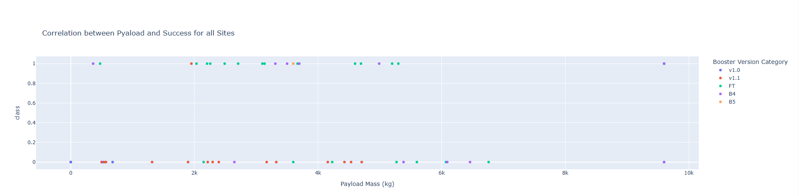
Which F9 Booster version (v1.0, v1.1, FT, B4, B5, etc.) has the highest launch success rate? Answer: FT WITH 65%

